Slide 1
(DO NOT SHOW) General Data Protection Regulation To-Customer Presentation
Audience:
CIO, CIO-1, CSO, CISO, CPO, Sr. IT Pro/Security/Privacy/Compliance
Usage guide:
This deck is relevant for both SMB and Enterprise accounts.
Slides 12 – 18 are designed for you to customize with your name, logo, offer details, and/or other information about your business.

Slide 2


Simplify GDPR compliance with
Microsoft 365
Name
Date
This presentation is intended to provide an overview of GDPR and is not a definitive statement of the law.

Slide 3

The General Data Protection Regulation (GDPR) imposes new rules on organizations in the European Union (EU) and those that offer goods and services to people in the EU, or that collect and analyze data tied to people in the EU, no matter where the organizations are located.
Enhanced personal privacy rights
Increased duty for protecting data
Mandatory breach reporting
Significant penalties for non-compliance
Microsoft believes the GDPR is an important step forward for clarifying and enabling individual privacy rights

Slide 4
Why is the GDPR critical now?
It all comes down to personal data.
GDPR regulates the collection, storage, use, and sharing of “personal data”, which is defined very broadly as any data that relates to an identified or identifiable natural person.
Data can reside in:
• Customer databases
• Feedback forms filled out by customers
• Email content
• Photos
• CCTV footage
• Loyalty program records
• HR databases
GDPR: Not just Europe.
The GDPR applies more broadly than many people think. The law imposes new rules on companies, government agencies, non-profits, and other organizations that offer goods and services to people in the EU or that collect and analyze data tied to people in the EU, no matter where the organizations are located.
GDPR is applicable to organizations of all sizes and all industries.

Slide 5


What are the key changes to address the GDPR?
Personal privacy
Controls and notifications
Transparent policies
IT and training
Individuals have the right to:
Access their personal data
Correct errors in their personal data
Erase their personal data
Object to processing of their personal data
Export personal data
Organizations will need to:
Protect personal data using appropriate security
Notify authorities of personal data breaches
Obtain appropriate consents for processing data
Keep records detailing data processing
Organizations are required to:
Provide clear notice of data collection
Outline processing purposes and use cases
Define data retention and deletion policies
Organizations will need to:
Train privacy personnel & employee
Audit and update data policies
Employ a Data Protection Officer (if required)
Create & manage compliant vendor contracts

Slide 6



What does this mean for data?
Stricter control on where personal data is stored and how it is used
Better data governance tools for better transparency, recordkeeping and reporting
Protecting customer privacy with the GDPR
Improved data policies to provide control to data subjects and ensure lawful processing

Slide 7

What does the GDPR mean for your organization?
Understanding your compliance risk is important
The GDPR can be can be challenging and complex to comprehend with roughly 160 requirements
Regulation is designed to protect personal data
Tighter controls on how you manage and protect personal data is required
Processes will need to be put in place
Proper tools and systems to accommodate various reporting requirements

Slide 8
How do I protect sensitive information?
INFORMATION PROTECTION LIFECYCLE
Detect
Classify
Protect
Monitor
Scan & detect sensitive data based on policy
Classify data and apply labels based on sensitivity
Apply protection actions, including encryption, access restrictions
Reporting, alerts, remediation
Devices
cloud
On premises

Slide 9

Accelerate GDPR compliance with Microsoft 365 Enterprise
Windows 10 Enterprise
Enterprise Mobility + Security
Office 365
Enterprise
Notes:
Microsoft 365 brings together the best of Windows 10, Office 365, and Enterprise Mobility + Security.
It’s a complete, intelligent solution, that empowers everyone to be creative and work together, securely.

Slide 10

Microsoft 365 is uniquely positioned to help with the GDPR
Assess and manage compliance risk
An on-going assessment of your compliance posture with actionable insights to improve your data protection capabilities.
Protect personal data
Data governance and protection of your sensitive data across devices, apps both on-premises and in the cloud.
Streamline processes
Built in audit-ready tools that help you collaborate between teams and manage your processes.

Slide 11
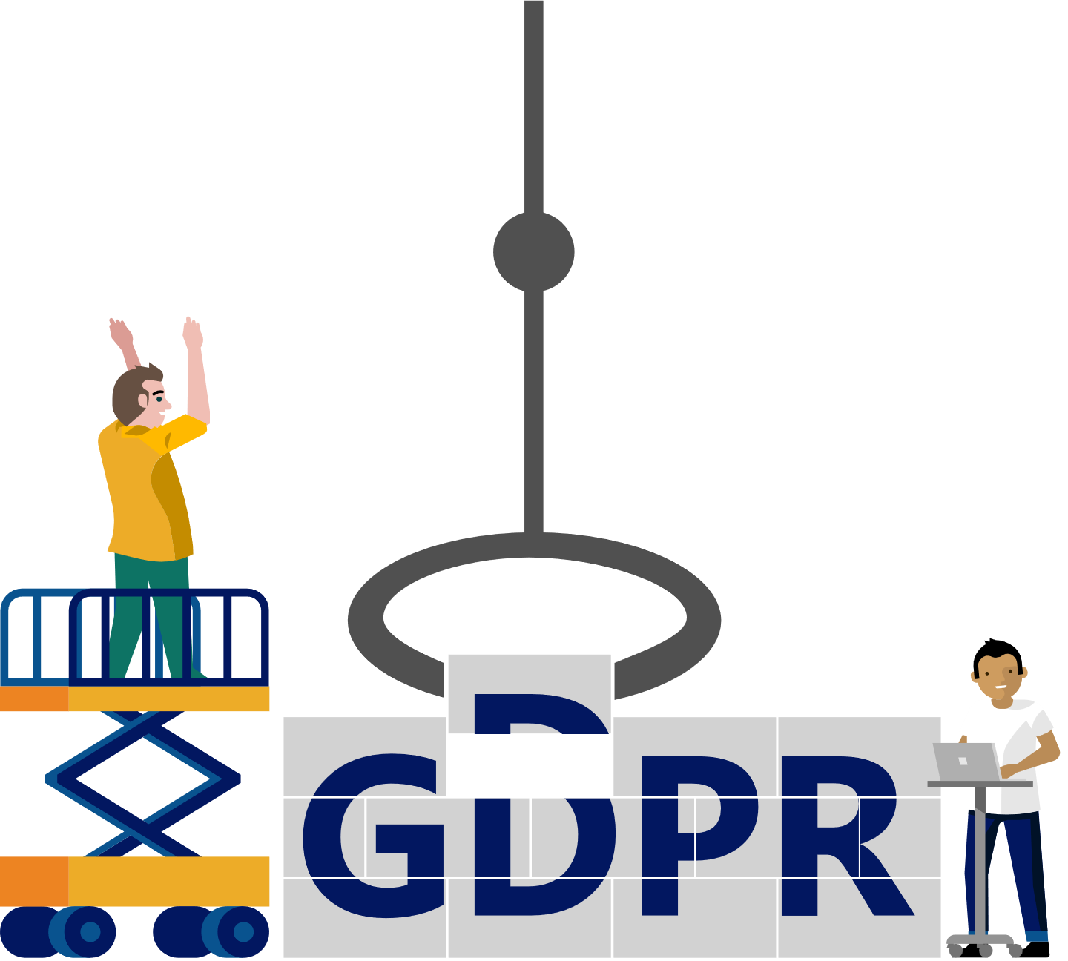

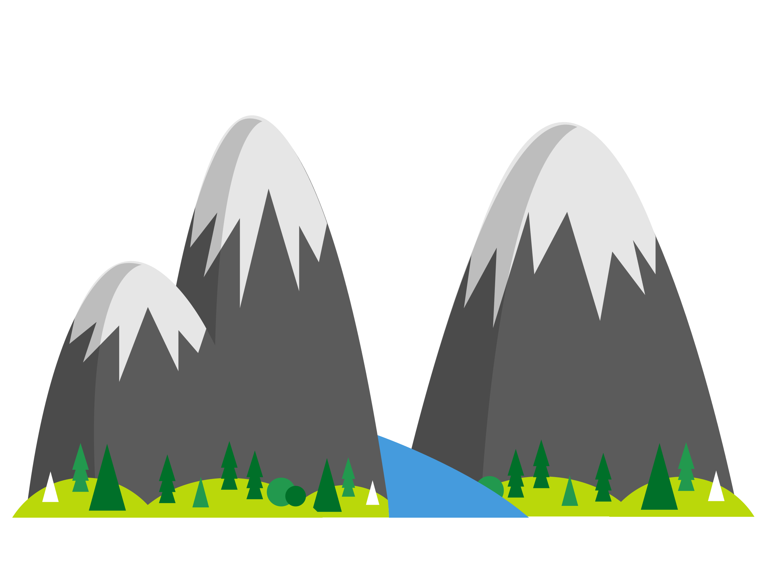
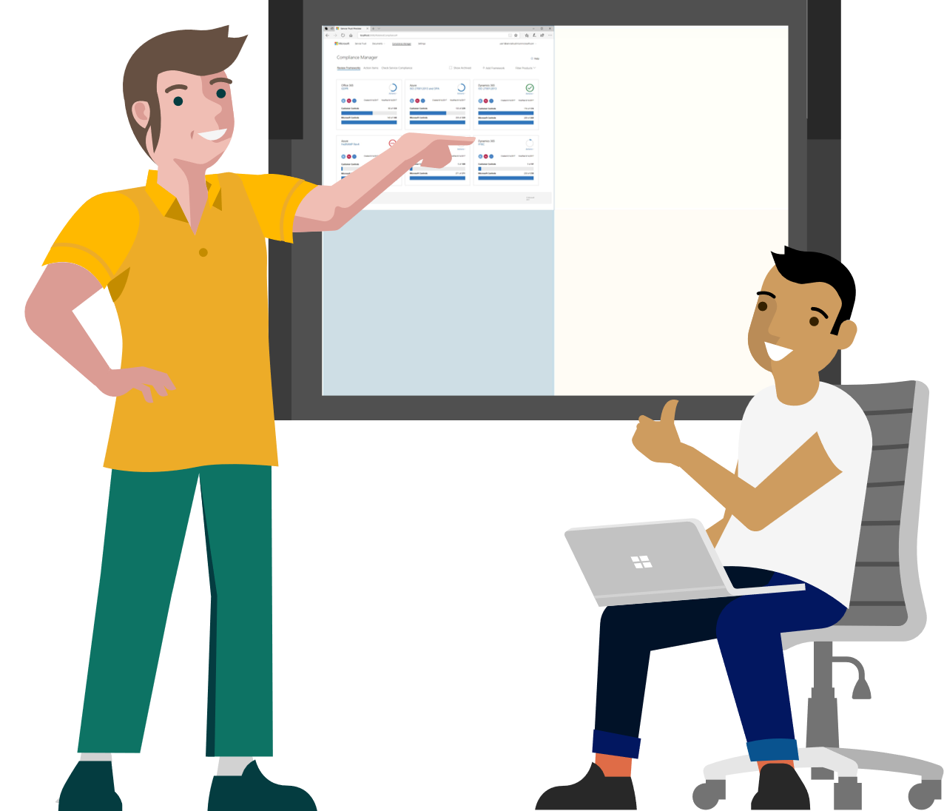
Partner services to help you prepare for and meet GDPR
1
2
3
4
Discovering where data resides.
GDPR data discovery Toolkit We’ll use the Microsoft Data Discovery Toolkit to discover and scan data sources within your organization for personal data. You’ll receive a detailed inventory of data sources, data they contain, and insights into how much of the data contains personally identifiable information (PII).
Managing compliance from one place.
Compliance manager To help the keep track of complex compliance requirements, we’ll show you how Microsoft Compliance Manager simplifies management of the GDPR and dozens of other regulations.
Laying the foundation.
GDPR Foundations TRAINING Get a better understanding about what the GDPR is and how it impacts your organization through the GDPR Foundations Training that covers all the basics you need to know.
Understanding the gaps.
GDPR Detailed assessment Get a thorough evaluation of your GDPR preparedness covering people, processes, and technology with our GDPR Detailed Assessment. You’ll leave with a tailored roadmap to increased compliance.

Slide 12


Partner name GDPR Foundations Training
To help you understand how the GDPR may impact your business, Microsoft and <<Partner Name>> have prepared the GDPR Foundations Training. These two presentations review who is subject to the GDPR, and explore consumer rights and business responsibilities under the GDPR.
GDPR Foundations Training —
Introduction to GDPR (Approximately 45 Minutes)
GDPR Foundations Training —
GDPR Half Day Offsite (Half Day Seminar)
Introduces business leaders to the basics of the GDPR, including a top-level overview of consumer rights and business responsibilities.
Delivers an in-depth review of the GDPR for those tasked with implementation of compliance and security procedures.
Audience: <Partner to insert, i.e. CIO, CTO, IT Department>
Duration: <XX hours>
Cost: <$XX>

Slide 13



Partner name GDPR Detailed Assessment
The journey to GDPR compliance starts with understanding the maturity of people, processes and technology within an organization.
In this 2-day workshop we’ll analyze the people, process, and technology your organization uses to work with data. We’ll work to:
Gain a common understanding of your compliance objectives and the GDPR requirements
Assess your organization’s GDPR maturity level, looking at your preparedness to execute on Discover, Manage, Protect, & Report activities
Create a GDPR compliance roadmap with a prioritized and actionable list of next steps that’s ready for legal and advisory review
Audience: <Partner to insert, i.e. CIO, CTO, IT Department>
Duration: <XX hours>
Cost: <$XX>

Slide 14


Partner Name GDPR Data Discovery Service
The GDPR regulates the collection, storage, use, and sharing of personal data. Many organizations need assistance in understanding and managing the personal data they have collected and retained.
Our GDPR Data Discovery service will help you:
Our GDPR Data Discovery deliverables:
Identify the systems where data is collected and stored
Understand why data was collected
Understand how data is processed and shared
Understand how long data should be retained
Detailed inventory of data sources
Data contained within those sources
Insights on quantity of data containing personally identifiable information (PII) or sensitive personal information potentially subject to the GDPR
Audience: <Partner to insert, i.e. CIO, CTO, IT Department>
Duration: <XX hours>
Cost: <$XX>

Slide 15

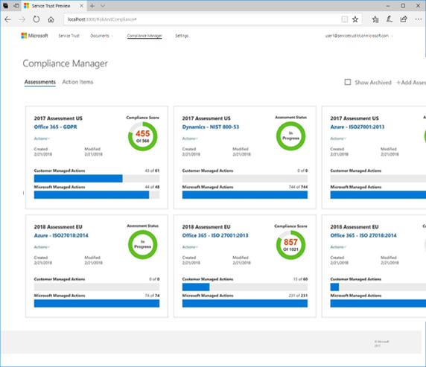

Partner name Compliance Manager Services
Compliance Manager is a cross–cloud services solution, offered as part of Microsoft 365, designed to help organizations assess and manage compliance risk and meet complex compliance obligations like the GDPR.
Compliance Manager performs an on-going risk assessment that reflects your compliance posture against data protection regulations when using Microsoft cloud services, along with recommended actions, and step-by-step guidance.
Our Compliance Manager services will help you:
Identify which activities or requirements should be tracked
Implement tracking and on-going assessment of compliance against regulatory requirements
Provide actionable insights and step-by-step guidance to help improve your data protection capabilities
Help you understand and use all the functionality included within Compliance Manager to simplify and streamline compliance
Audience: <Partner to insert, i.e. CIO, CTO, IT Department>
Duration: <XX hours>
Cost: <$XX>

Slide 16

Next steps
1.) add here
2.) add here
3.) add here
Partner URL here

Slide 17



Why Us?
We’re experts at…
Supporting point #1
Supporting point #2
Supporting point #3
We can help you…
Supporting point #1
Supporting point #2
Supporting point #3
We can manage your…
Supporting point #1
Supporting point #2
Supporting point #3

Slide 18


